Slide 1
WHEY PROTEIN QUALITY PREDICTOR
MOHAMMED IRFAN
PY DS JUNE BATCH 1 – TRAINER : SABIR K

Slide 2
INTRODUCTION
Whey protein is a high-quality protein derived from milk during the cheese-making process.
Whey protein is one of the most widely used dietary supplements among fitness enthusiasts and athletes.
The quality of whey protein varies significantly across different brands and product types.
This project focuses on building a machine learning-based system to predict the quality of whey protein using its nutritional and product features.

Slide 3
PROBLEM STATEMENT
Consumers often rely on labels and marketing claims, which may not accurately reflect true quality.
Traditional laboratory testing methods are reliable but expensive and time-consuming.

Slide 4
OBJECTIVE
To predict the quality of whey protein using machine learning
To classify whey protein into quality categories (High / Medium / Low)
To develop a user-friendly web application for prediction
To assist consumers and fitness enthusiasts in making informed decisions

Slide 5
PROPOSED SYSTEM
The proposed system uses machine learning techniques to predict the quality of whey protein supplements
Users provide nutritional and product details through a web-based interface
A trained machine learning model analyzes the processed data and predicts the quality category
The predicted result is displayed instantly as High, Medium, or Low quality
The system provides a cost-effective, fast, and user-friendly alternative to traditional laboratory testing

Slide 6
FLOW DIAGRAM
Data Collection
Data Preprocessing
ML Model Training
Quality Prediction
Result Output

Slide 7
TECHNOLOGIES
Programming Languages : Python
Libraries :
  Sklearn
  Pandas
  Numpy
  Matplotlib
  Seaborn
  Joblib
Streamlit

Slide 8
METHODOLOGY
Collecting the Dataset, and loading the dataset to the system
Data Analysis : Analysing the DataSet, finding important insights
Data preprocessing : Dealing with missing values, Handling Outliers,
Dividing the data into training and testing data
Training the ML model using training data.
Testing the model : calculating performance (Accuracy Score)
Showing the final result using a local website (Streamlit)

Slide 9
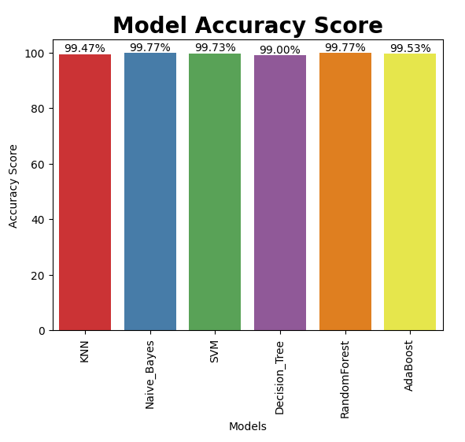
RESULTS
Accuracy :

Slide 10
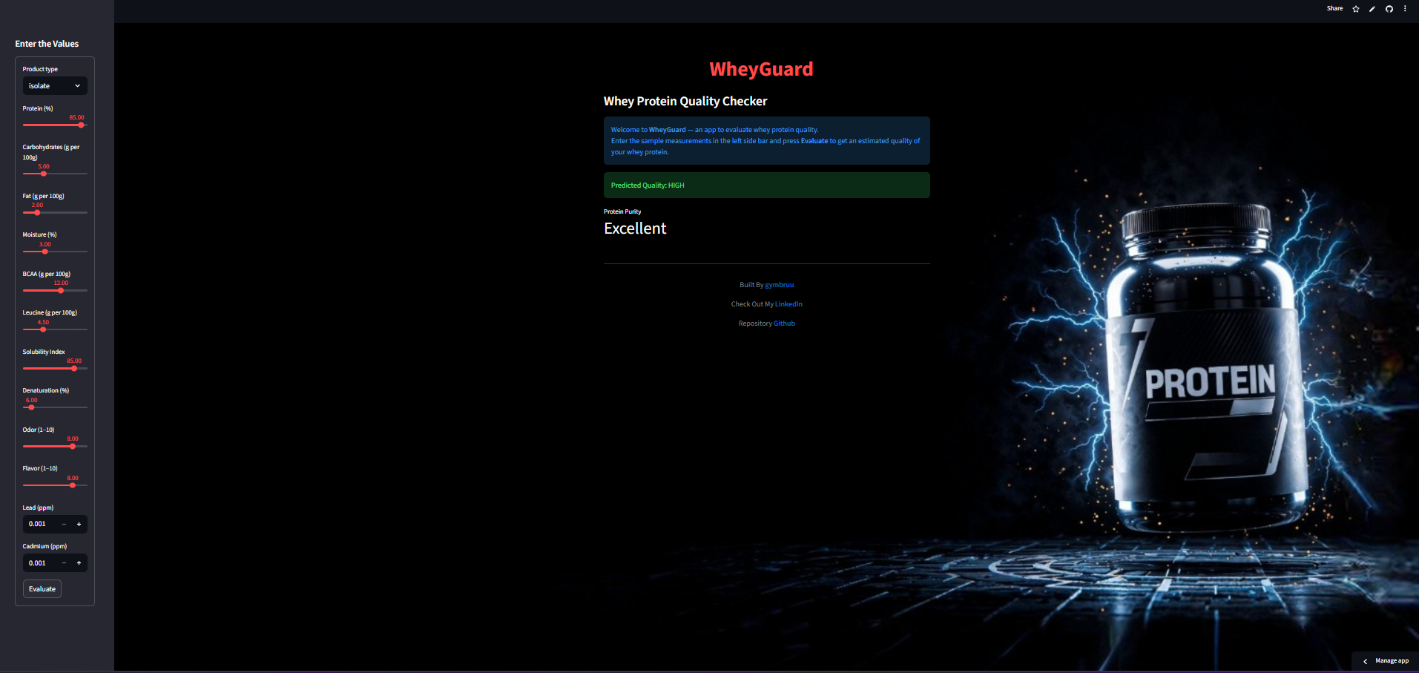
OUTPUTS

Slide 11
DEVELOPMENT SIDE
To view Streamlit Web click here : STREAMLIT
To view Git Repository Click here : GITHUB

Slide 12
ADVANTAGES
Less time for prediction
Accurate
DISADVANTAGES
ImproperDataset

Slide 13
FUTURE ENHANCEMENT
Try To improve the quality of the Dataset .
Integration with real laboratory test data
Mobile application development.

Slide 14
CONCLUSION
The project successfully demonstrates the use of machine learning to predict the quality of whey protein supplements
Nutritional and product features were effectively analyzed to classify whey protein into High, Medium, and Low quality categories
The proposed system provides a fast, cost-effective, and reliable alternative to traditional laboratory testing methods
Integration with a user-friendly web application (WheyGuard) makes the system accessible to non-technical users

Slide 15
THANKYOU

